Slide 1
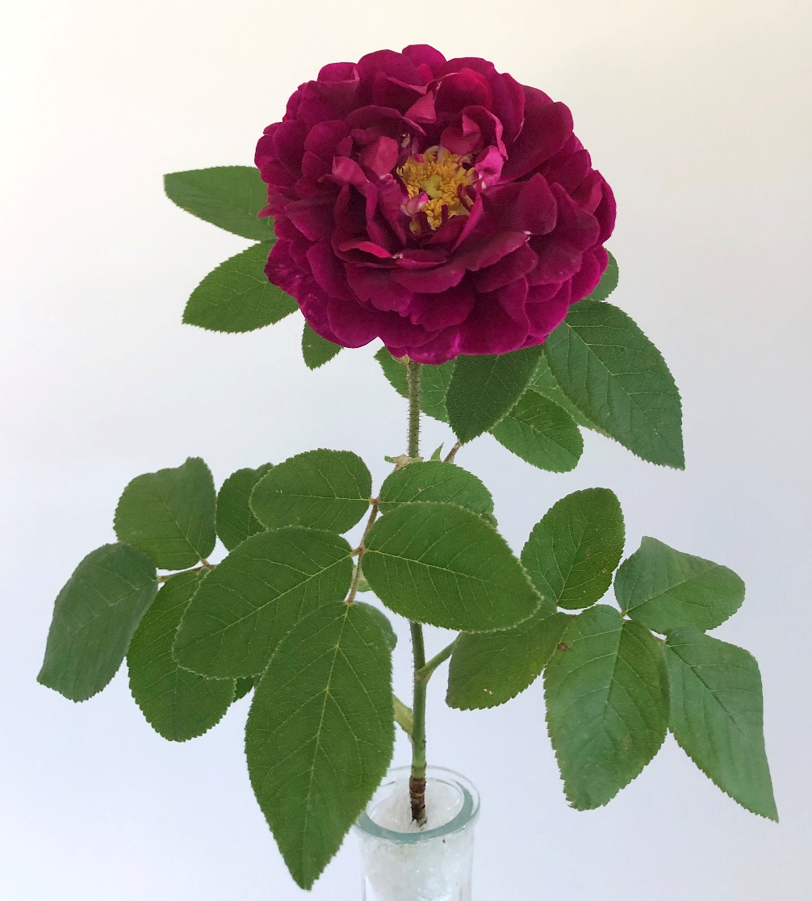
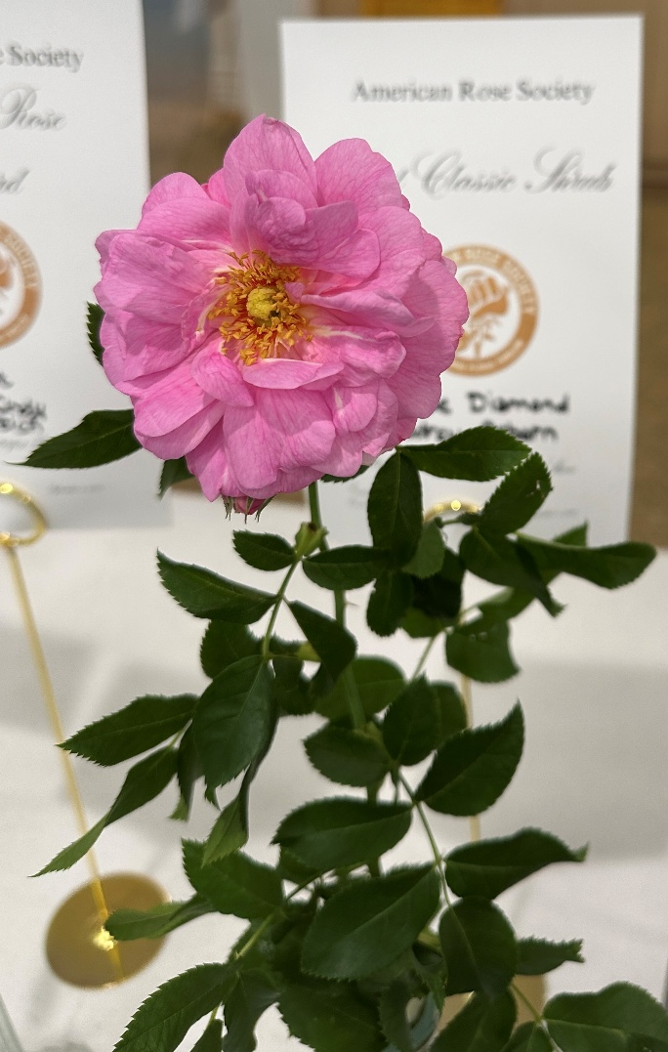
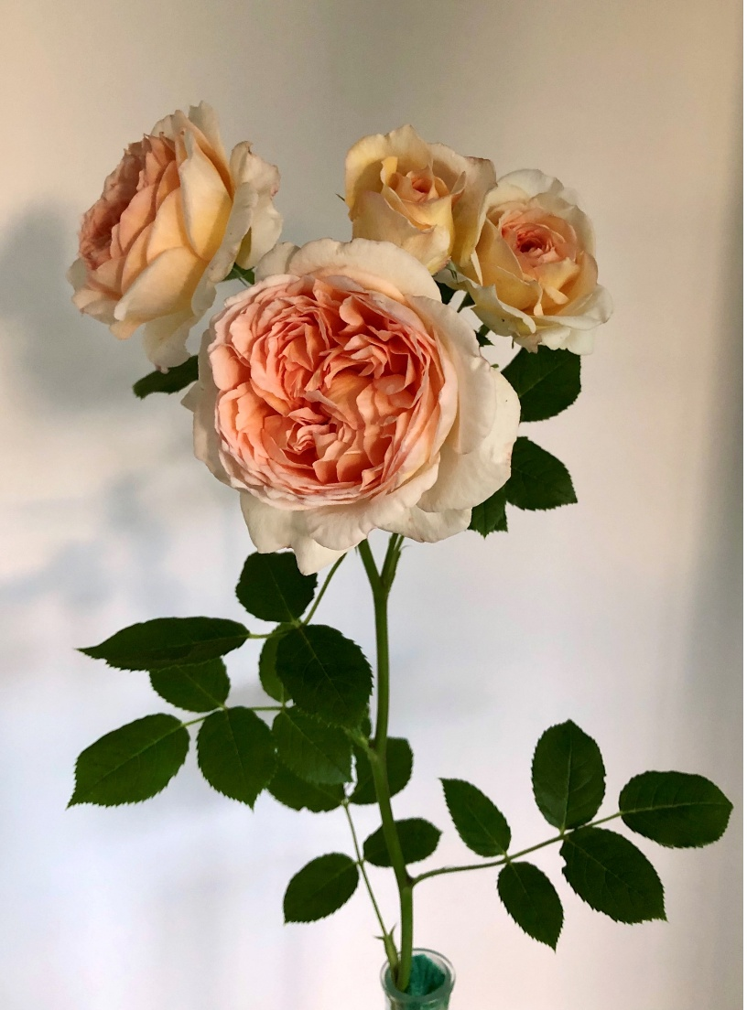
JUDGING OGRs, SHRUBS & CLIMBERS
Tuscany Superb
Cape Diamond
Bathsheba
YANKEE DISTRICT JUDGING SCHOOL
March 6, 2026

Slide 2
Family Tree for the Genus (Rosa) approved by ARS, 1999
Species Roses
Old Garden Roses
Modern Roses
Species are the original naturally occurring varieties of roses. They are the original parents of the various Old Garden Rose varieties, which in time produced the Modern Rose varieties

Slide 3
Major Old Garden Rose Classes
Albas
Bourbons
Centifolias
Damasks
Hybrid Chinas
Hybrid Gallicas
Hybrid Perpetuals
Hybrid multifloras
Mosses
Noisettes
Portlands
Species
Teas
Hybrid Multifloras are in bold print, because this is a somewhat recent change by the ARS.

Slide 4
Lesser Known OGR Classes
Ayrshires
Boursaults
Hulthemias
Hybrid Bracteatas
Hybrid Eglanterias
Hybrid Foetidas
Hybrid Sempervirens
Hybrid Spinosissimas
Hybrid Setigeras
Misc. OGRs

Slide 5
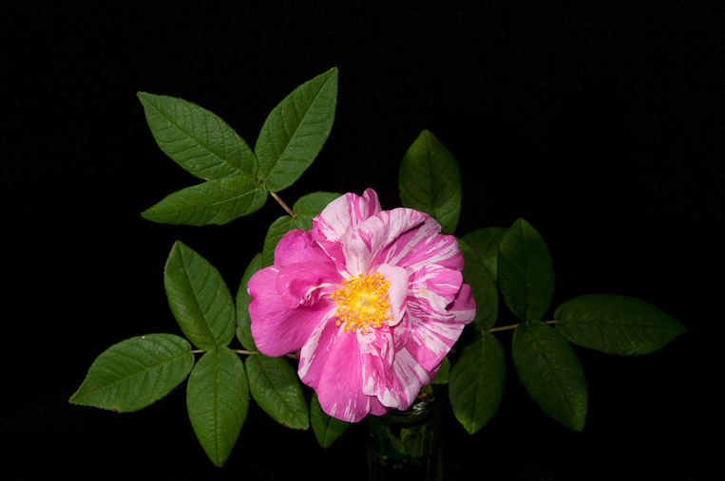
This species rose should be exhibited under it’s AEN (ARS Exhibition Name ) of Rosa gallica versicolor. An acceptable synonym is Rosa Mundi.
When a judge sees a synonym being used, the AEN should be noted on top of the tag, and the specimen placed with others of the same variety in that class if any are present

Slide 6
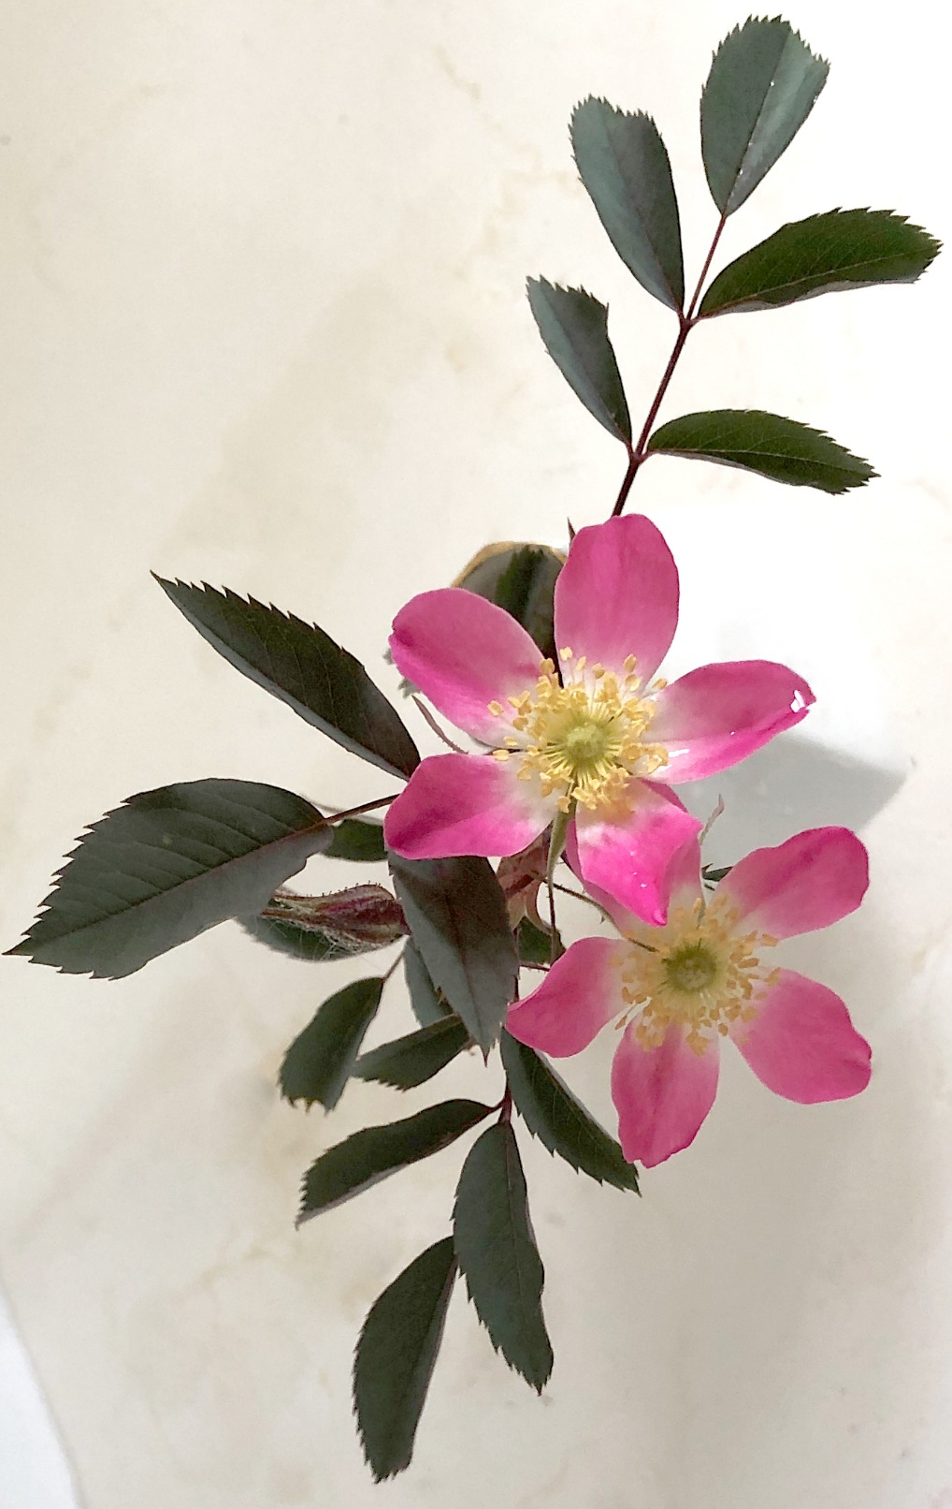
Rosa rubrifolia is the AEN for this species rose that has a more common pseudonym of Rosa glauca.
Be aware that many of the oldest OGRs have multiple alternative names

Slide 7
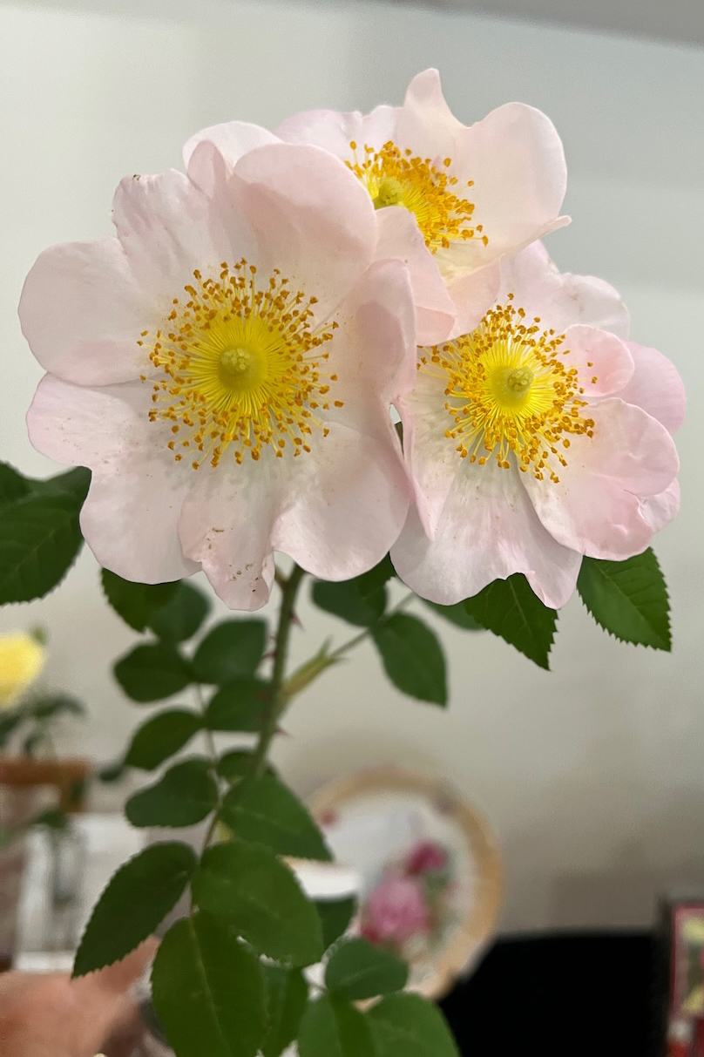
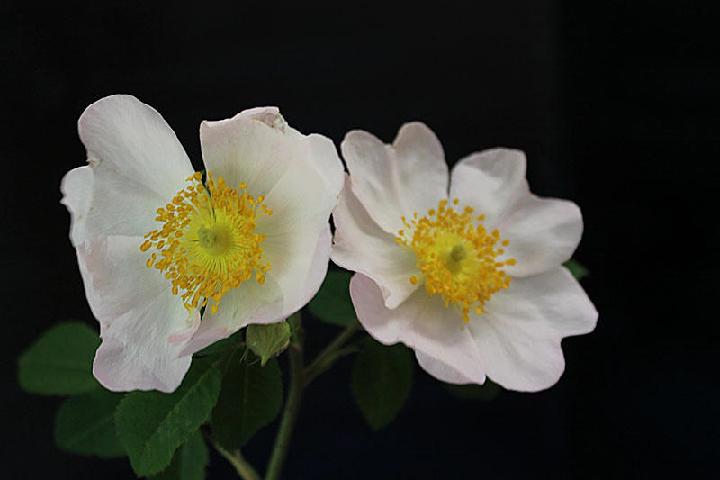
Gallica macrantha, Misc. OGR <1750, was classified as a species until recently
Like most singles, it is best on the day it blooms, it starts as a fresh pink and by evening is white

Slide 8
Old Garden Roses (OGRs)
In 1966, ARS defined OGRs as those whose classification types existed prior to 1867, which was the year of the introduction of La France, now considered to be the first hybrid tea rose.
Although the prime elements of judging for species and OGRs are the same as for modern hybrids, the defining standards are quite different.

Slide 9
Judging Old Garden Roses
Form: Most species & OGRs are usually most beautiful at the fully open stage. Some varieties of the tea, hybrid perpetual, and noisette classifications closely approximate exhibition form. These entries should be judged according to the definition of exhibition form. No preference is given to exhibition form.
Both a center green pip and quartering are attributes that give some species and OGRs diversity and distinction and should be rewarded not penalized.

Slide 10
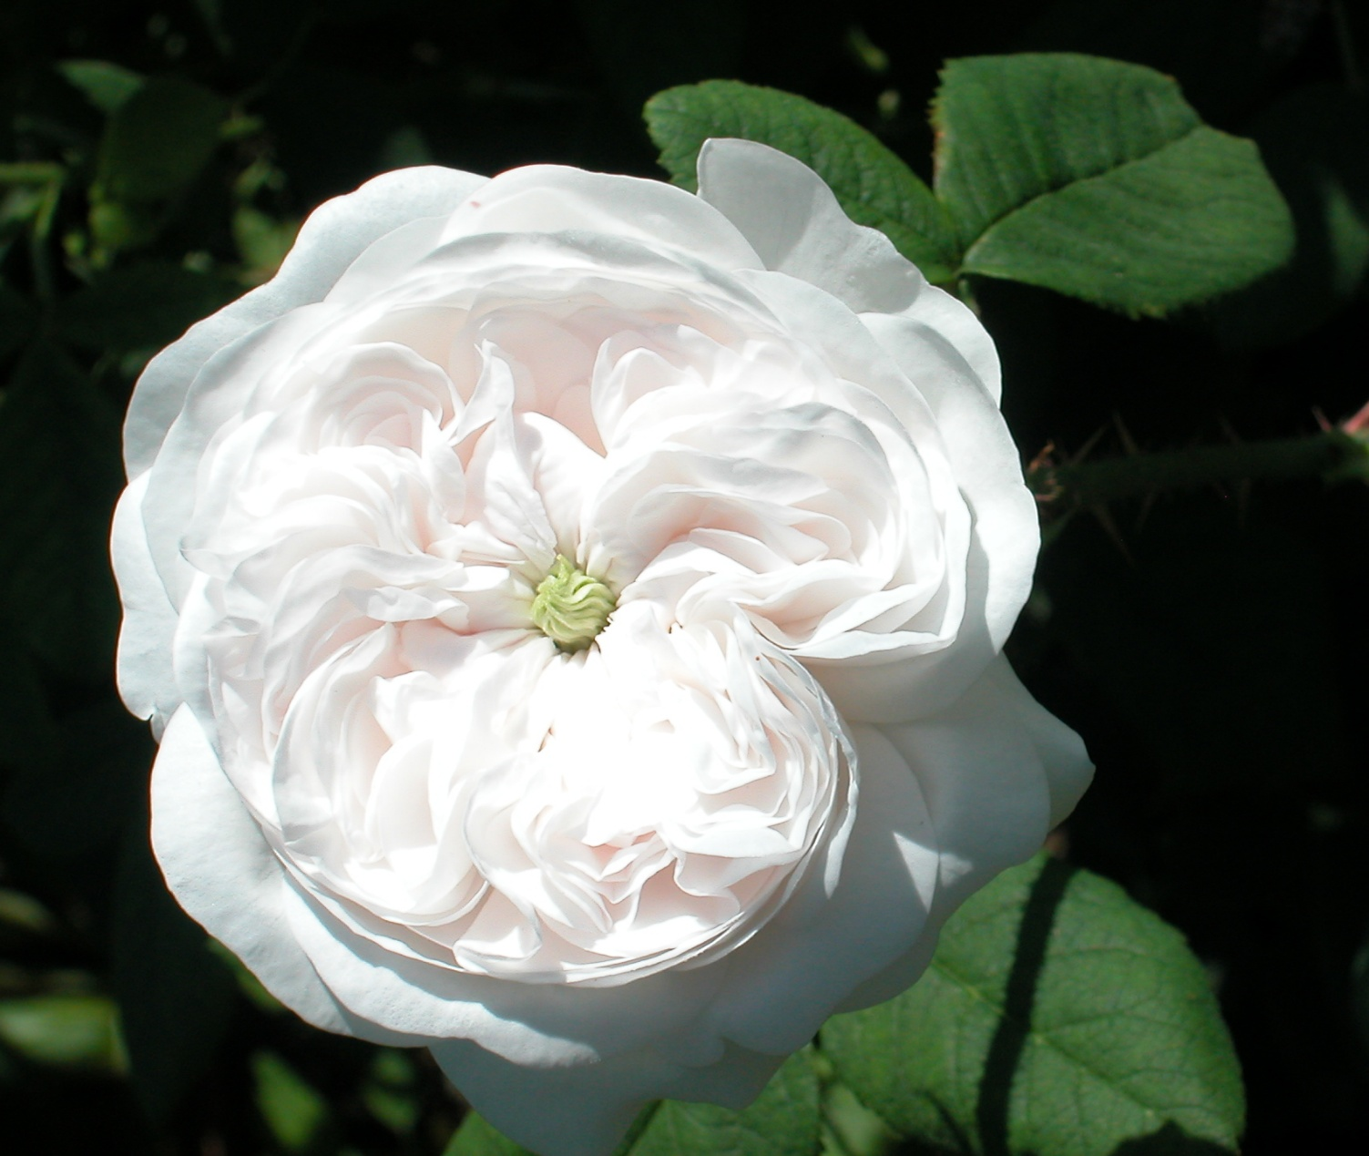
Madame Hardy, Damask 1832
Showing button eye and quartering

Slide 11
Color: Stripes and color blotches are often typical in OGRs and are not faults. Colors may be subtle.
However many Old Garden Roses react negatively to refrigeration by showing a bluing of the petals, which should be penalized
The petals at the back of the bloom often become whitened or brown when the bloom is past its peak

Slide 12
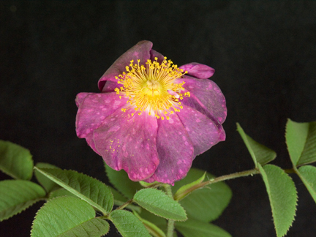
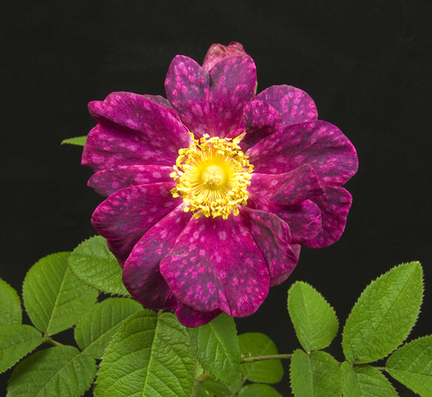
Alain Blanchard after a day of heat and dust in the horse barn. All substance lost, but stamens might fool you into thinking it is fresh
Normal spotting and “blotches” of Alain Blanchard HGal 1839

Slide 13
Judging Old Garden Roses
Substance:
Besides firmness in appearance, the color of both the upper and lower surfaces of the petals and the freshness of the stamens are good indicators of substance quality.
Be aware, some varieties such as Celsiana have crinkly petals that may appear to have lost substance, unless you are familiar with the variety
Stem and Foliage:
Like climbers and some shrubs, many OGRs have short stems and may be exhibited stem on stem. An entry without a stem-on-
stem will always be considered superior to an entry with stem-on-stem, all other factors being equal.

Slide 14
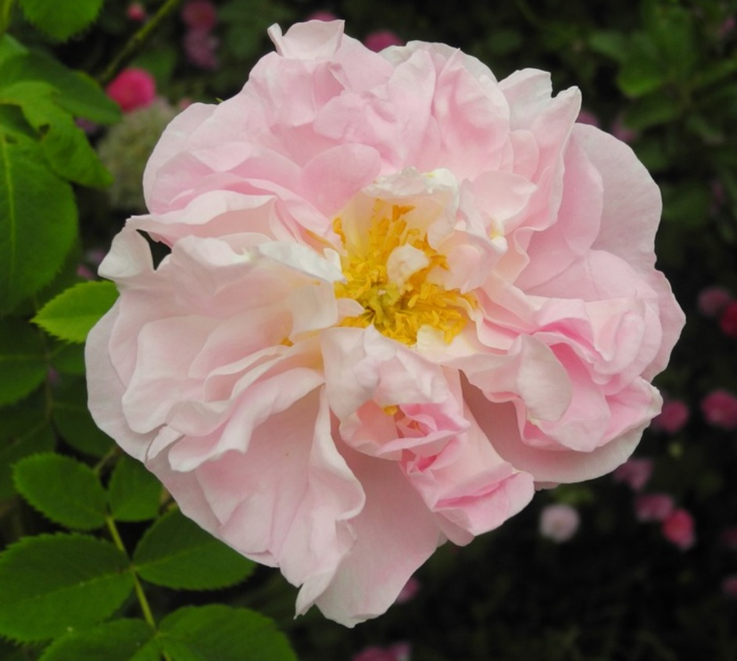
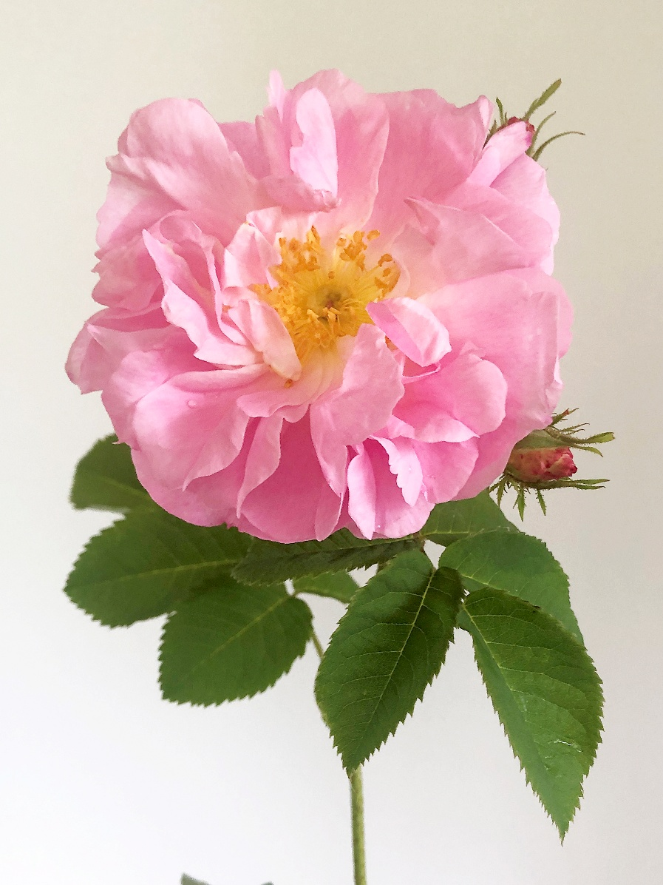
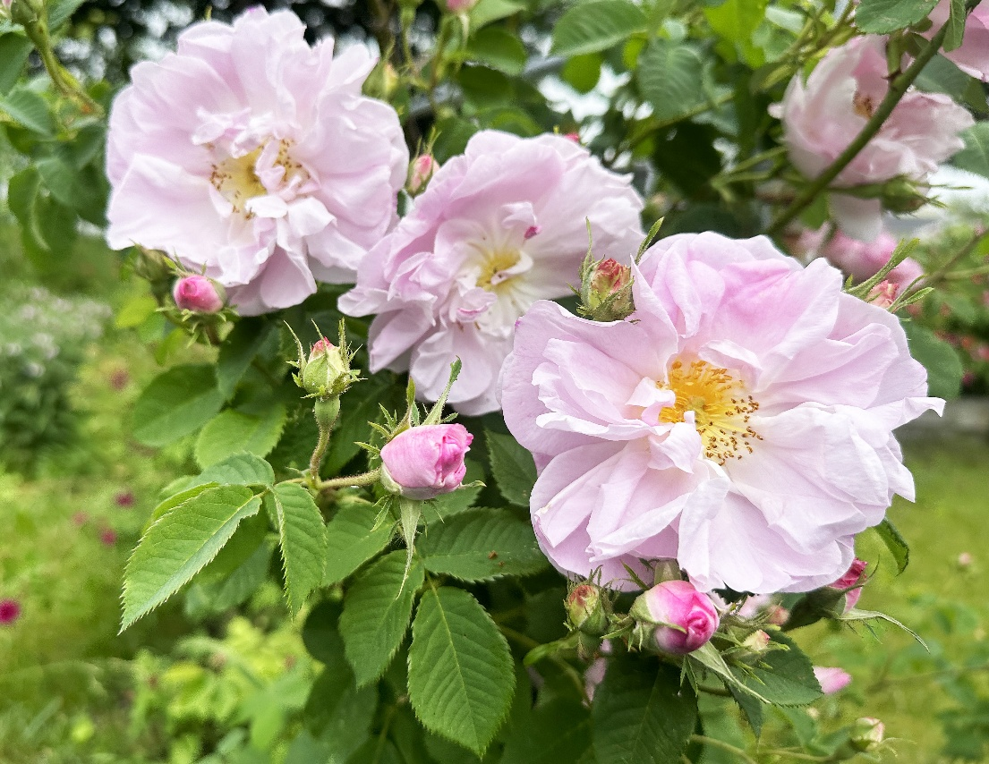
Loose variable crinkly form of Celsiana, Damask <1817

Slide 15
Judging Old Garden Roses
Balance and Proportion
Many OGRs produce blooms on short stems. So the size of the bloom(s) may be disproportionate to the supporting stem and foliage. An exhibit that does not show this disproportion should be considered superior to those that do.
Size:
Wide range of bloom size seen in OGRs. Size must be judged on the basis of that which is typical for a given variety.

Slide 16
Judging Old Garden Roses
With all these differences then, how can a judge who doesn’t grow OGRs successfully judge them?
Study the commonly grown OGRs seen at shows.
If unsure of identification, ask another judge or judges.
Before making any species or OGR rose award, the judge should check both the classification and date of introduction of the rose to which the award is to be given to verify that it is eligible to receive the award.
Consider growing some!

Slide 17
PRESENCE OF SIDE BUDS
Climbers, shrubs and OGRs do not have to be disbudded.
Species and OGRs may be shown as one-bloom-per-stem, with or without side buds or with multiple florets with side buds. There is no preference for judging purposes.
Side buds should enhance the overall beauty of the exhibit. Buds that detract from the overall appearance of the exhibit may be removed
Unwanted growth may be removed by the exhibitor. In that case, points should be deducted for stem and foliage only if the residual scar is distracting.

Slide 18
OGRs and Species Awards
Genesis Award: Best blue-ribbon-winning species rose. The rose must belong to a classification under species (Sp) as designated in any of the ARS officially recognized publications.
If the Genesis Award is not offered, species roses may be entered in the OGR sections and will then be eligible for the Dowager Queen Award or Victorian Award, depending on their date of introduction into commerce.

Slide 19
Dowager Queen
Awarded to the best blue ribbon winning OGR variety introduced prior to 1867, including any rose whose exact year of introduction is unknown but which is known to have been in existence prior to 1867.
Dowager Queen eligible varieties are generally indicated by a “**” preceding the AEN in many ARS publications.

Slide 20
Victorian Rose Award
Awarded to the best blue ribbon winning OGR introduced in 1867 or later, including recent introductions, or whose date of introduction, though in 1867 or after, is unknown.
Common example

Slide 21
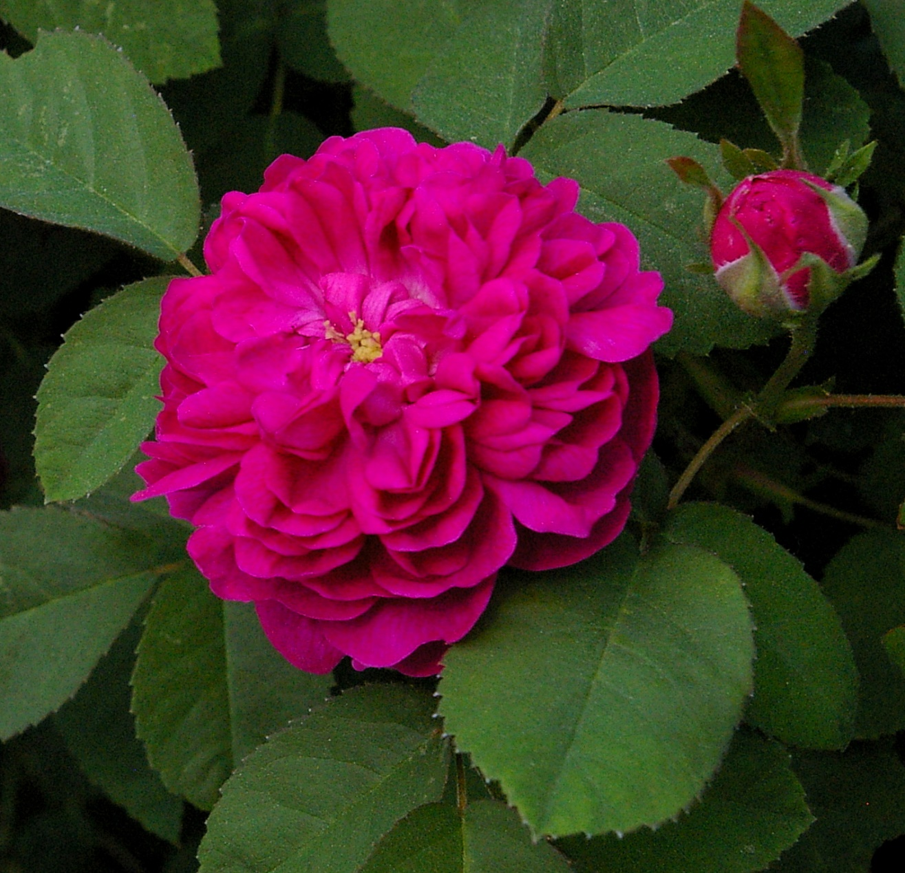
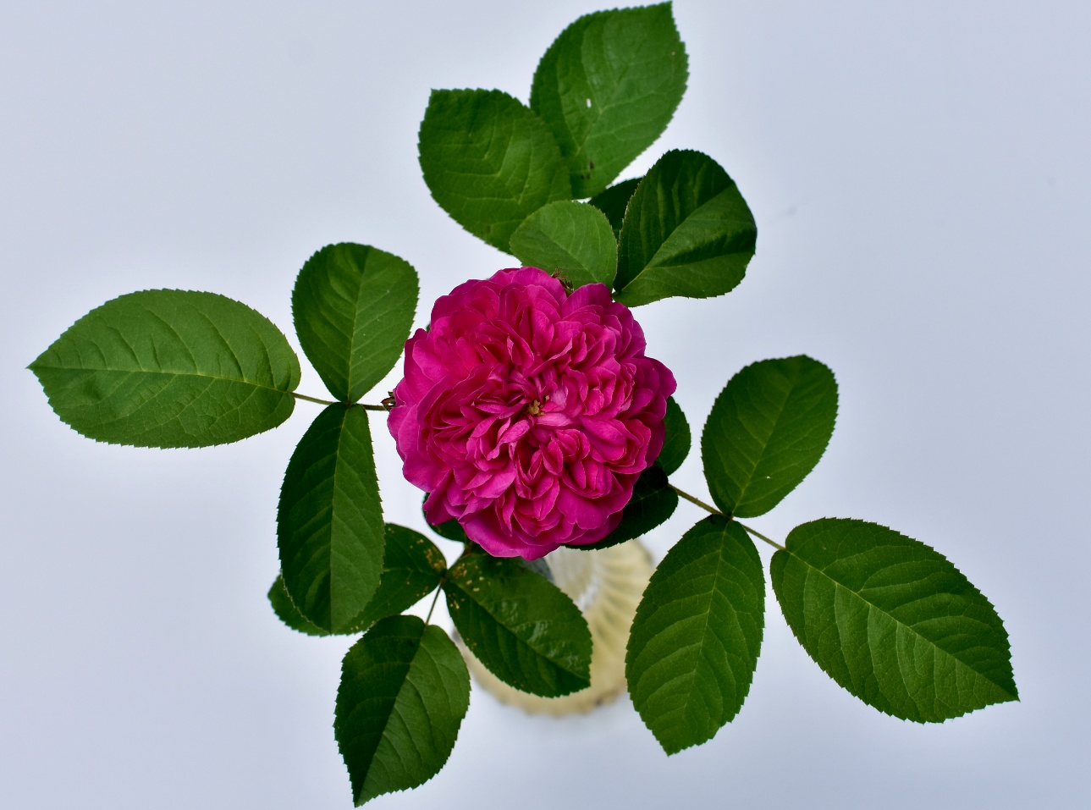
Beautifully framed by foliage. A frequent winner of the Victorian Award
Rose de Rescht, P about1880
(sometimes listed as unknown date)

Slide 22
IMPORTANT OGR NOTES
ALWAYS check an official ARS publication to check if an entry is a classification considered an OGR and what it’s date of introduction was.
BE AWARE that a rose introduced right up to the present day can be an OGR, if it is registered as such because of its breeding. It would be shown in the Victorian class.
Examples: Summer Blush, A 1974 and George Oliva, Hmulti 2009 and Treasure Trail M 2009

Slide 23
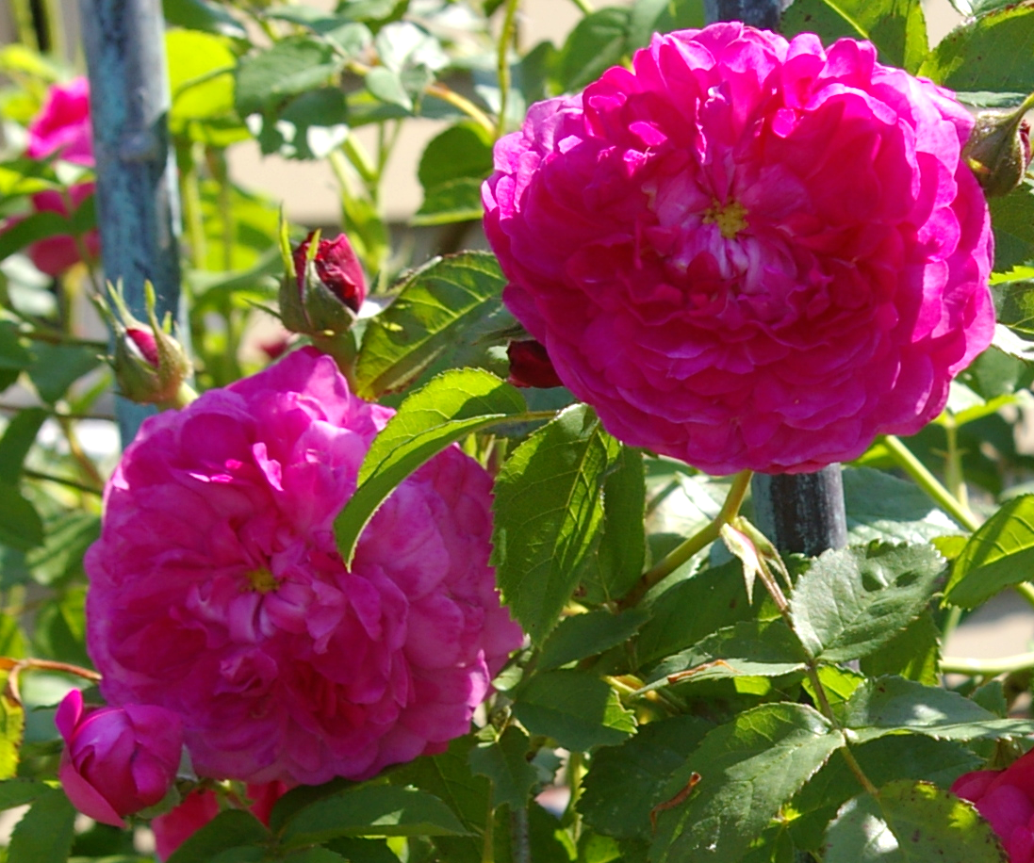
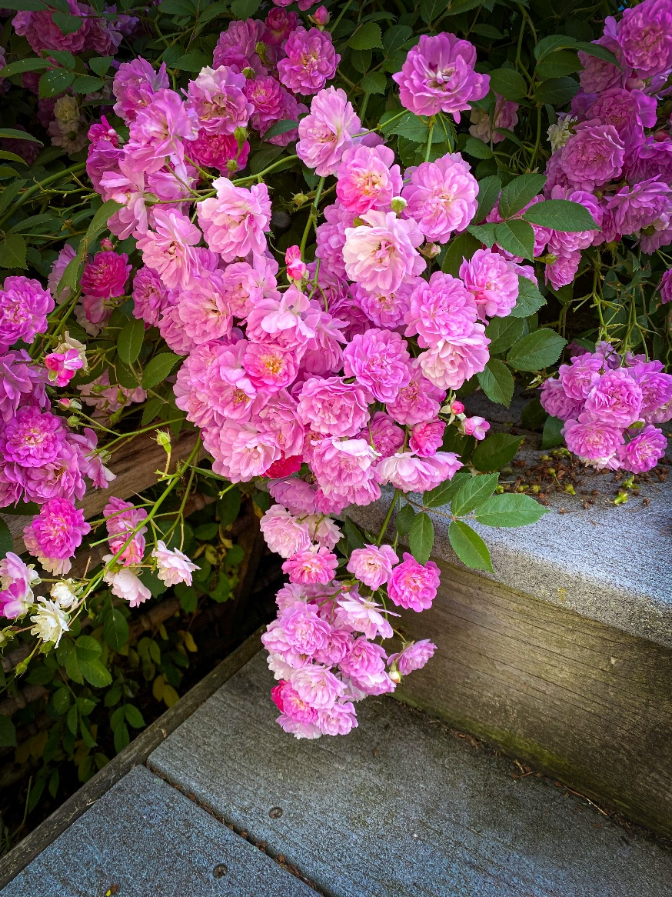
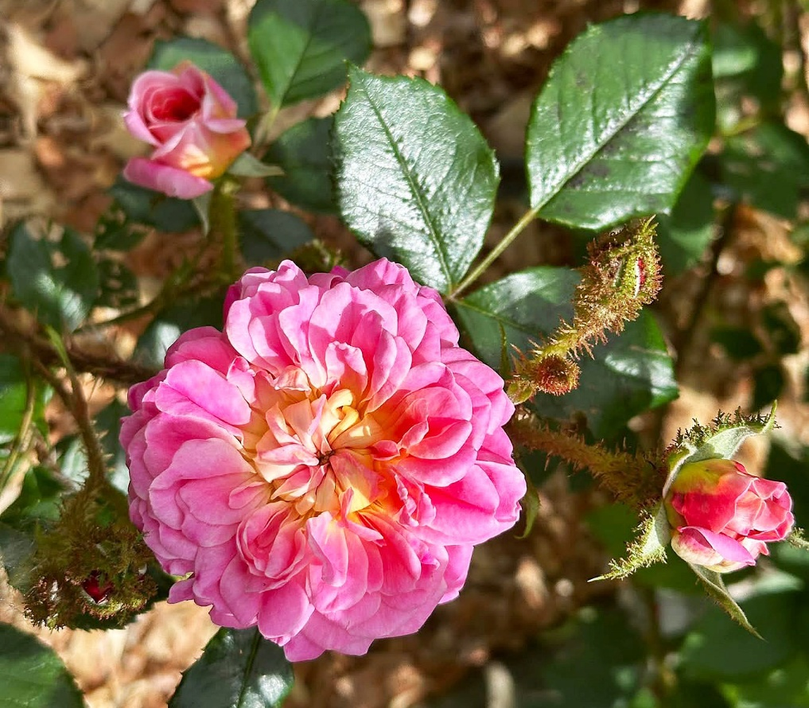
Button eye in Summer Blush, Alba 1974
Trailing habit of George Oliva , Hmulti 2017
Mossy buds on Treasure Trail, Moss 2009

Slide 24
SHRUBS :
The shrub class consists of a large, diverse group of roses which do not predate 1867 and which do not fit easily into the already established classes
Shrubs are divided into two major groups:
CLASSIC and MODERN

Slide 25
CAUTION: There are roses which appear to be climbers (like Sally Holmes (S) or Ilse Krohn Superior (Hkor), which are actually classified as shrubs. Don’t be embarrassed to check your Handbook For Selecting Roses or other reference unless you are quite sure of a class. CLASSIFICATIONS ARE NOT CARVED IN STONE. There have been many changes over the years Older references will often have outdated classification

Slide 26
Classic Shrubs:
Hybrid Kordesii (HKor) i.e. Cape Diamond, Dortmund, Party Hardy, Ilsa Krohn Superior
Hybrid Musk (HMsk) i.e. Darlow’s Enigma, Ballerina, Felicia, Hera’s Song
Hybrid Rugosa (HRug) i.e. Therese Bugnet, Linda Campbell
Hybrid Moyesii (HMoy) i.e. Nevada

Slide 27

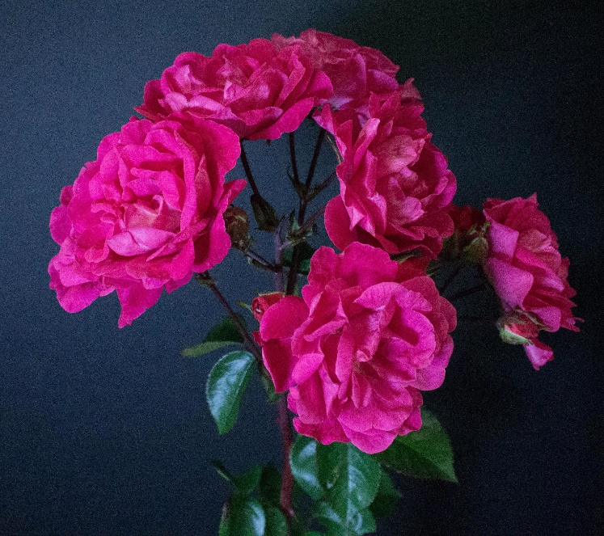
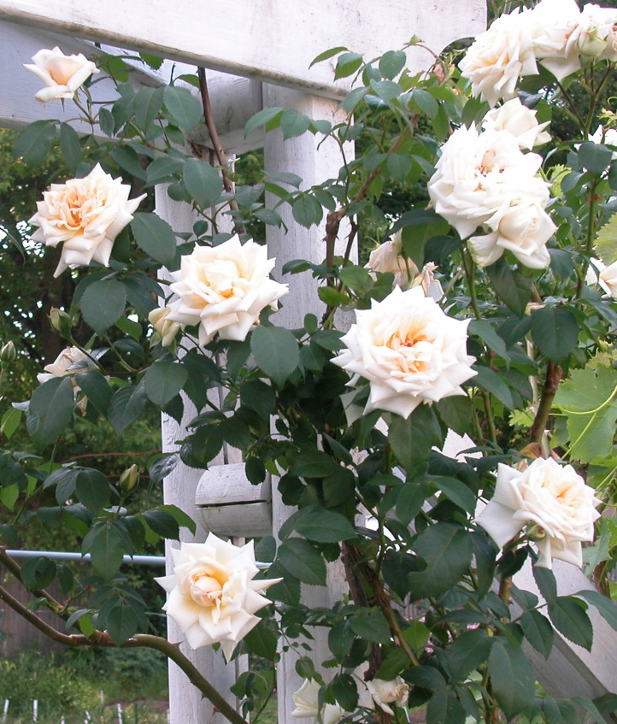
Hybrid Kordesii (HKor) i.e. Cape Diamond, Dortmund, Nouvelle France (Party Hardy), Ilsa Krohn Superior
Party Hardy
Cape Diamond
Ilsa Krohn Superior

Slide 28
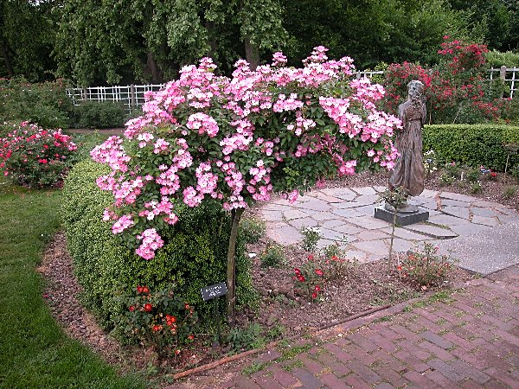
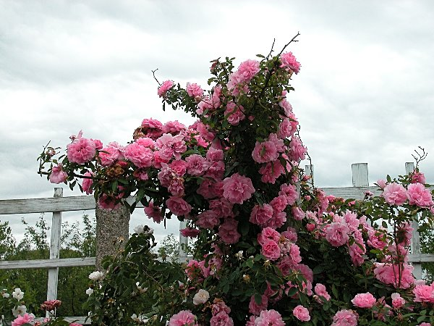
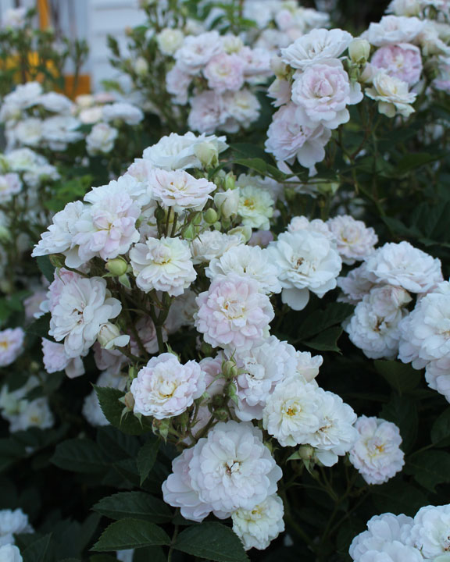
Hybrid Musk (HMsk) i.e. Darlow’s Enigma, Ballerina, Felicia, Hera’s Song
Ballerina
Felicia
Hera’s Song

Slide 29
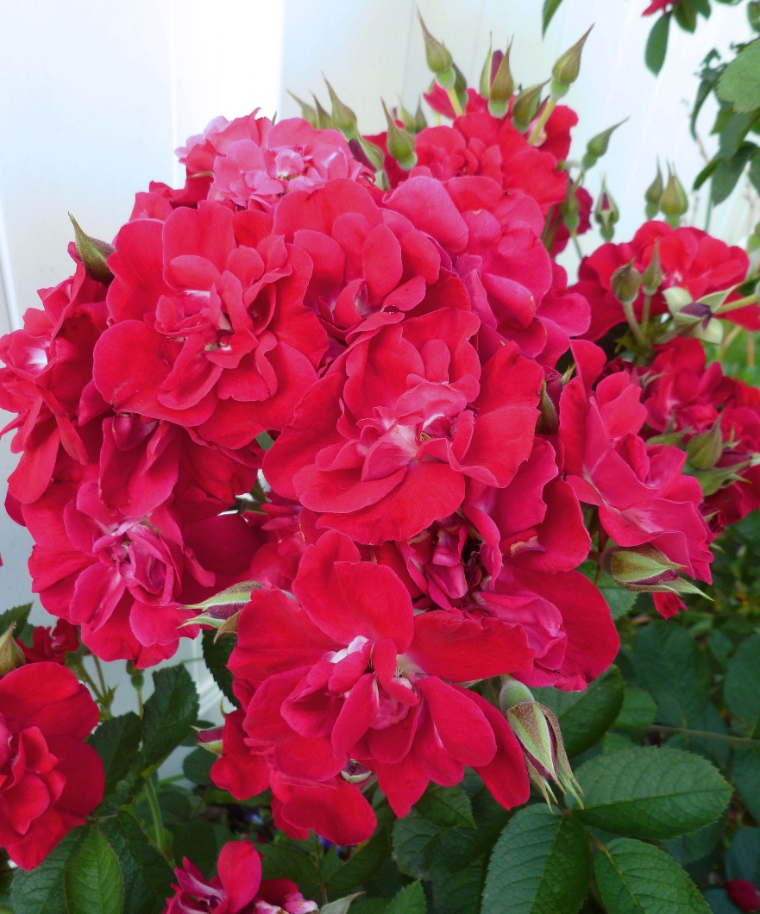
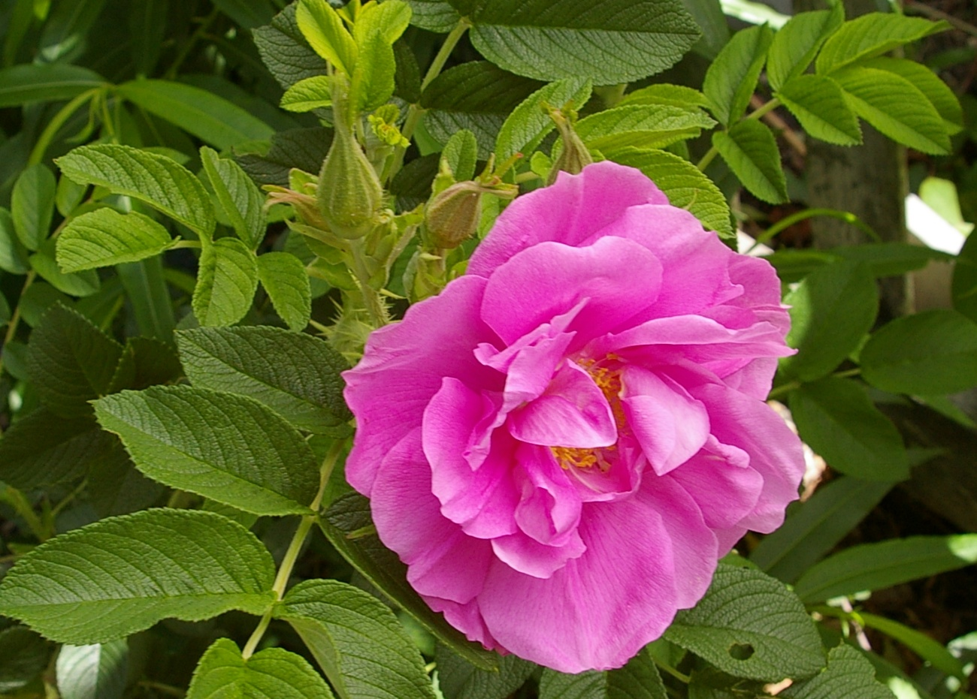
Hybrid Rugosa (HRug) i.e. Therese Bugnet, Linda Campbell, Pierette Pavement (Yankee Lady)
Pierette (Yankee Lady)
Linda Campbell

Slide 30
Best Classic Shrub:
Any HKor, HMoy, HMusk or HRugosa
NOTE: Rose varieties in in ARS publications will not have a generic Classic Shrub identifier. Specimens entered in the classic shrub class will be labelled as one the above classifications.
Species rugosas, such as R. rugosa alba are species roses and eligible for the Genesis Award, but not eligible for the Classic Shrub Certificate.

Slide 31
In 2021, the ARS divided “Modern Shrubs”
into three sub-Classifications:
English-Style (Eng) – Old fashioned blooms reminiscent of OGRs
Ground Cover (Gc) – Compact bushes with low spreading form
Landscape Shrubs (S) - Would have been more accurately named “The Catch-All Group.” Any shrub that does not fit the above 2 categories, The classification also includes varieties that are winter hardy and suitable for northern landscape applications

Slide 32
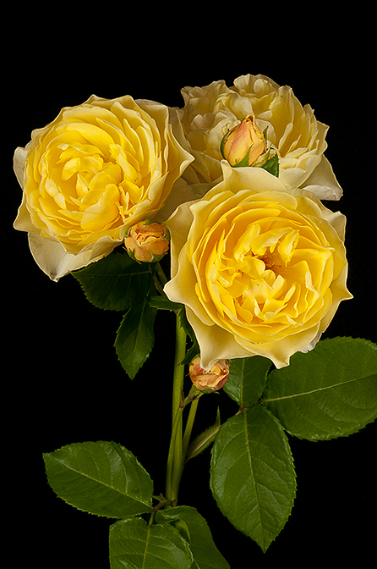
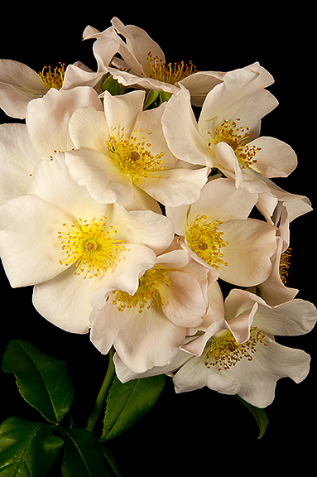
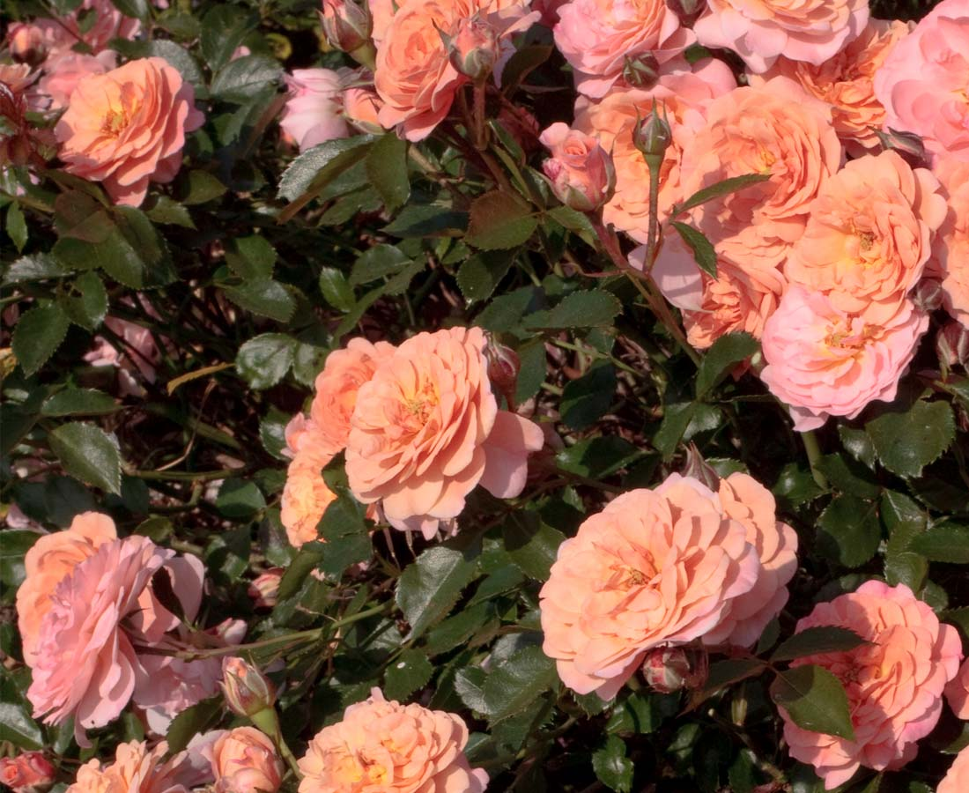
Apricot Drift (Gc)
Graham Thomas(Eng)
Sally Holmes(S)

Slide 33
ARS Shrub Award Certificates:
Best Classic Shrub: Only HMsk, HRg, Hkor, Hmoy are eligible
ARS Gold, Silver, and Bronze Modern Shrub Certificates (Queen, King, Princess): Chosen from all modern shrubs. Including their subdivisions of English(Eng), Ground cover(Gc) and Shrub(S) Best Shrub: Only awarded if neither Best Classic and Best Modern certificates are not offered

Slide 34
Judging Shrubs & Climbers
The judging of shrubs and climbers is challenging because so many flower forms are found in these classification.
They share the following standards with OGRs
*Both one-bloom-per-stem and sprays are allowed *Stem on stem is allowed but may incur penalty depending on degree of distraction
*There is no requirement to disbud. Buds should enhance the overall beauty however or be removed
And importantly, each specimen should be judged by the standards of its variety, so no preference should
be given to varieties that exhibit exhibition form.

Slide 35
Judging Shrubs & Climbers
FORM / BALANCE and PROPORTION : Same considerations as the OGR classes
COLOR and SUBSTANCE: Same considerations as all classes
STEM and FOLIAGE: The stem should be strong enough to support the spray without a distracting nod. Some climbers have very thin lateral stems naturally, and the blooms tend to nod.
But because the stem and foliage only account for 20
points, the judge should not overly penalize specimens that have faults in stem and foliage

Slide 36
Judging Climbers
Only those varieties classified as Large-Flowered Climbers (LCl), Hybrid Wichuranas (HWich), Hybrid Giganteas (HG) and now Ramblers(R) are to be exhibited in the climber class.
Note: varieties classed as Cl HTs, Cl Min, Cl F, etc. should be shown with their non-climbing counterparts
Also Note: Hybrid Multifloras such as Seven Sisters and Russelliana which were commonly thought of as ramblers are now classified in the OGR class, not as ramblers.

Slide 37
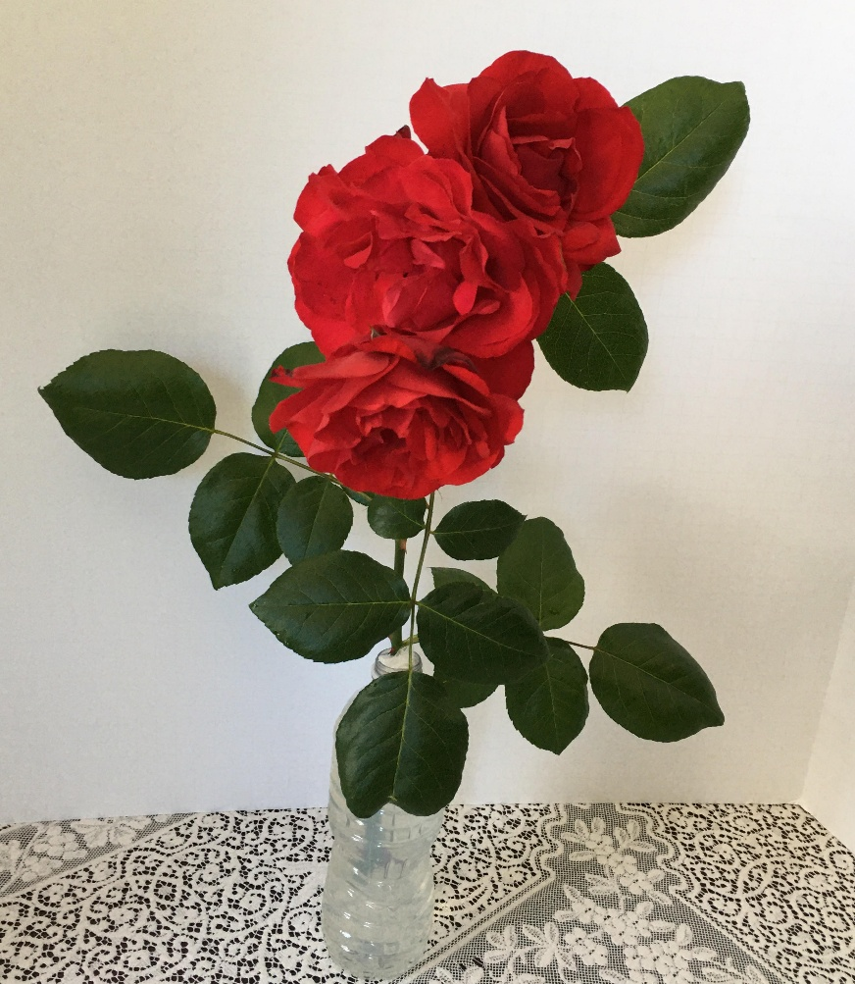
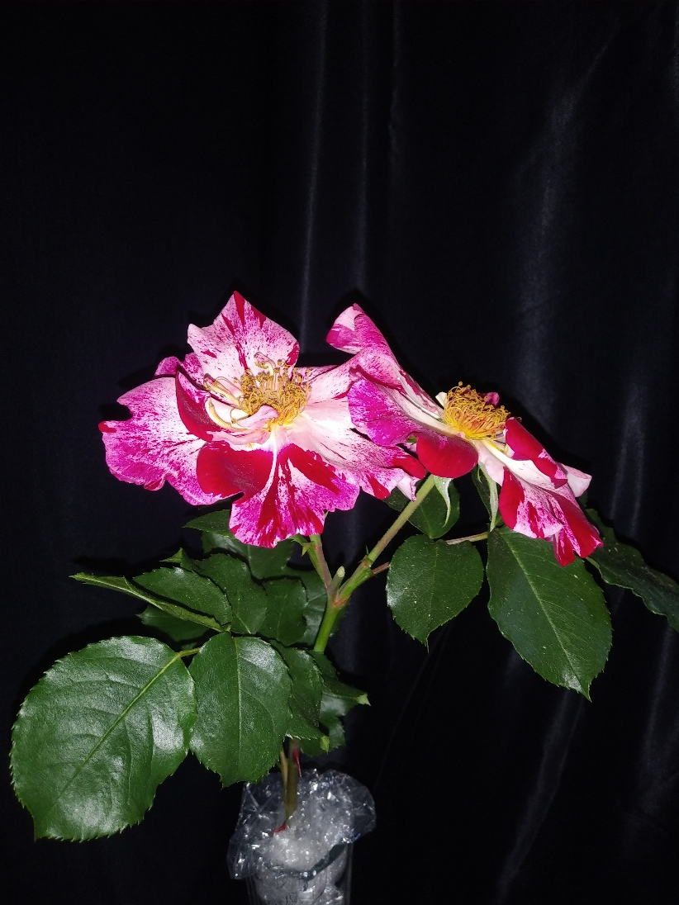
Dublin Bay
Bathsheba
Fourth of July

